Slide 1



Slide 2
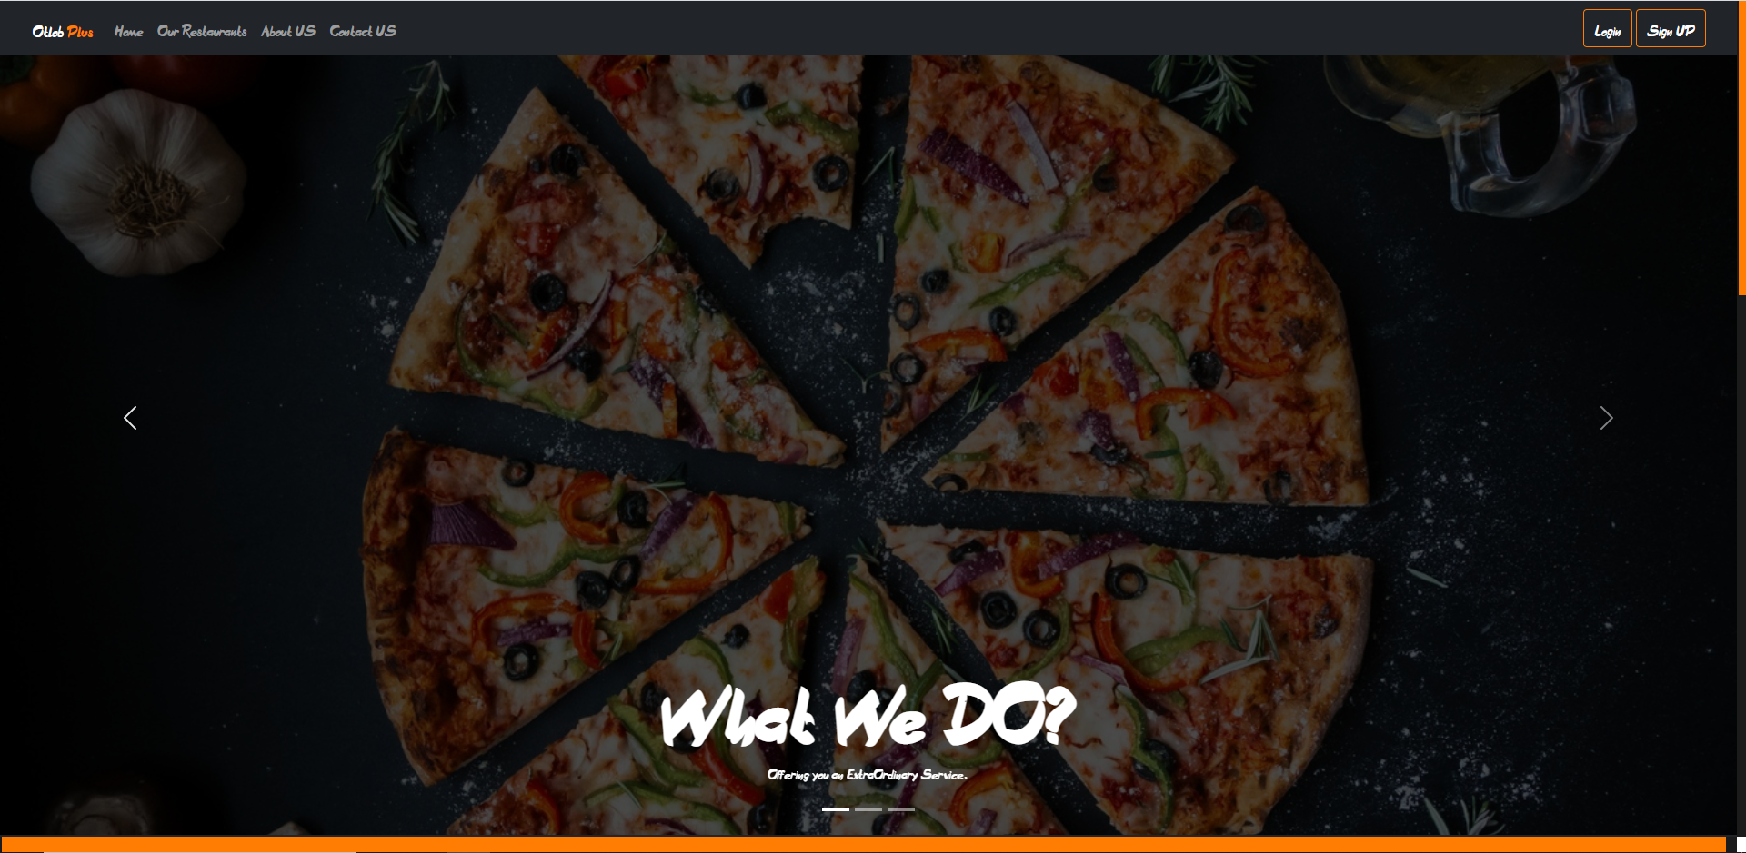
Home Page

Slide 3
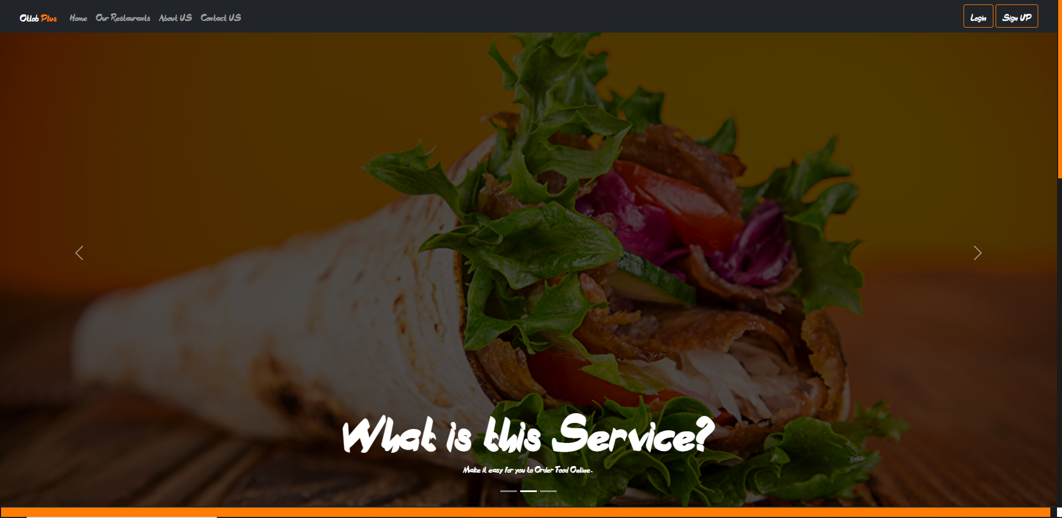

Slide 4


Slide 5

Login Page

Slide 6
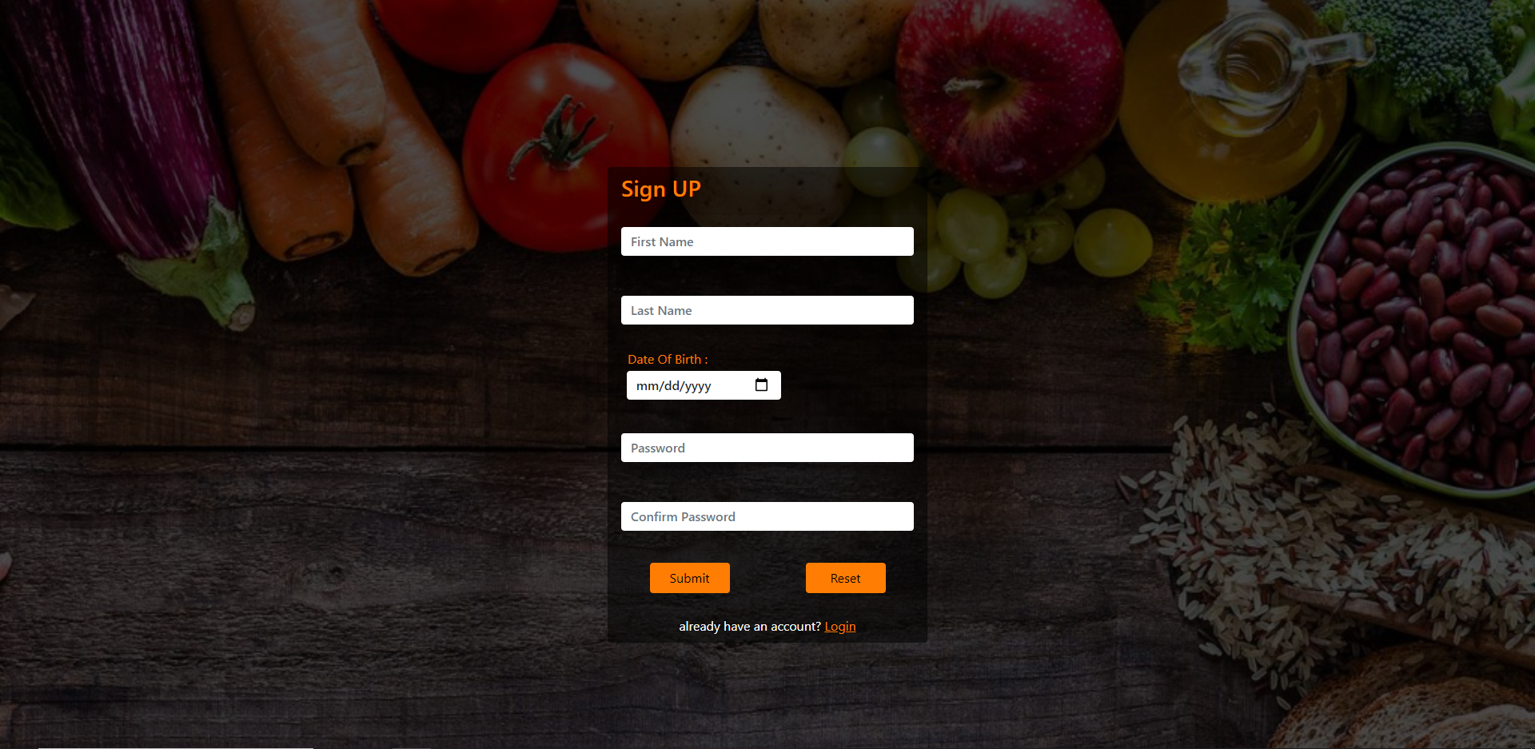
Sign up Page

Slide 7
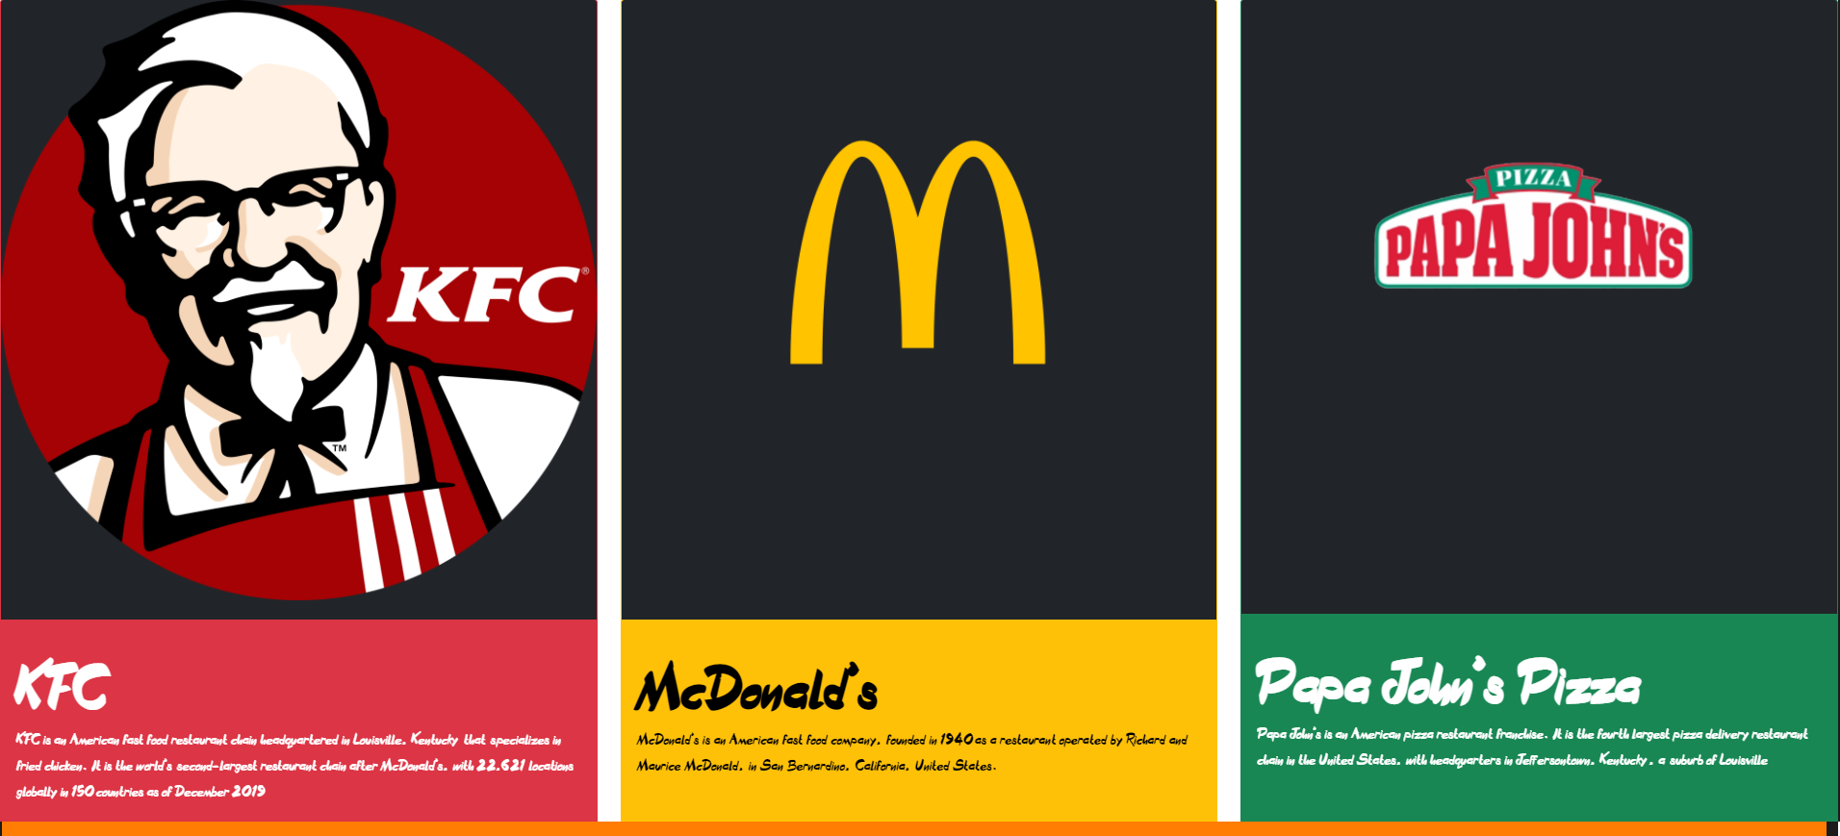
Restaurants Section

Slide 8
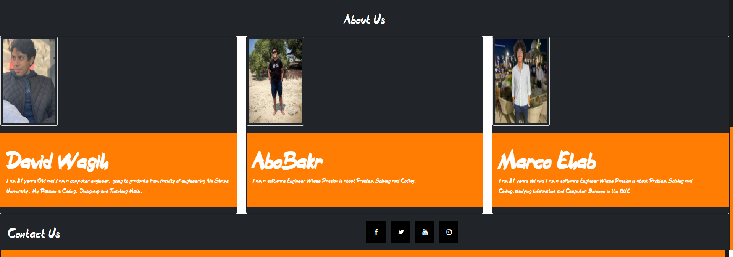
About Us and Contact section

Slide 9
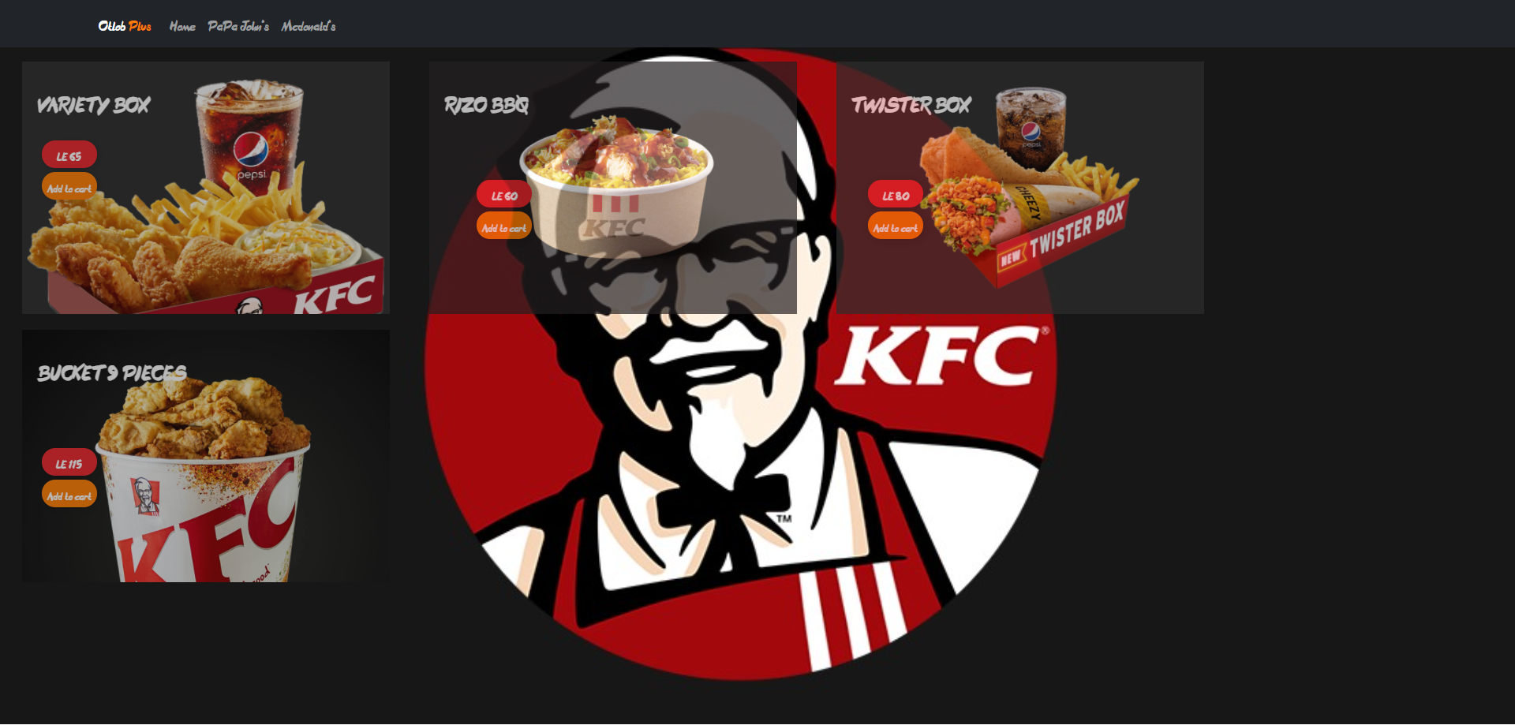
Kfc menu

Slide 10
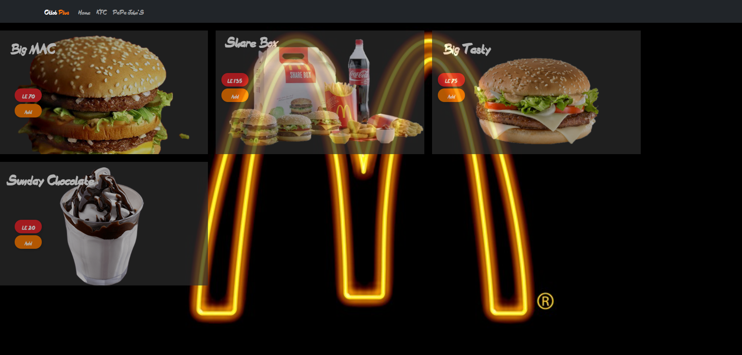
Mc donald’s menu

Slide 11
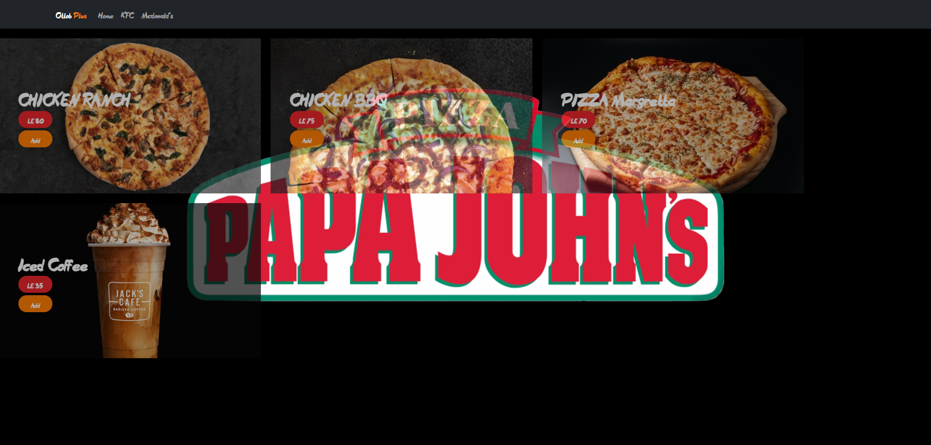
Papa john’s menu

Slide 12
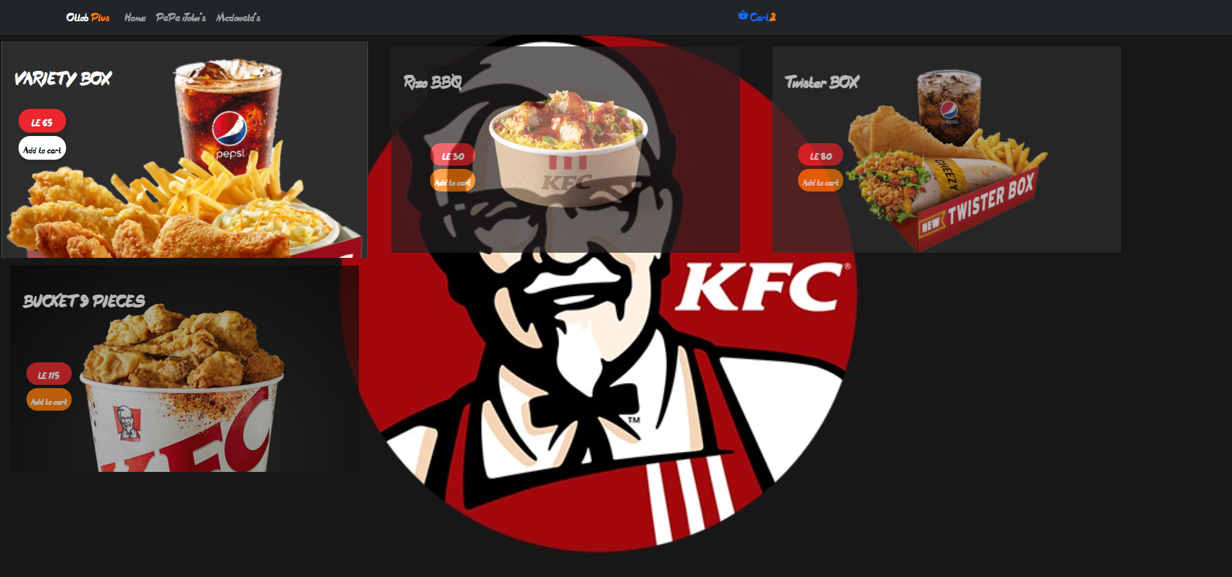
Add to cart action

Slide 13
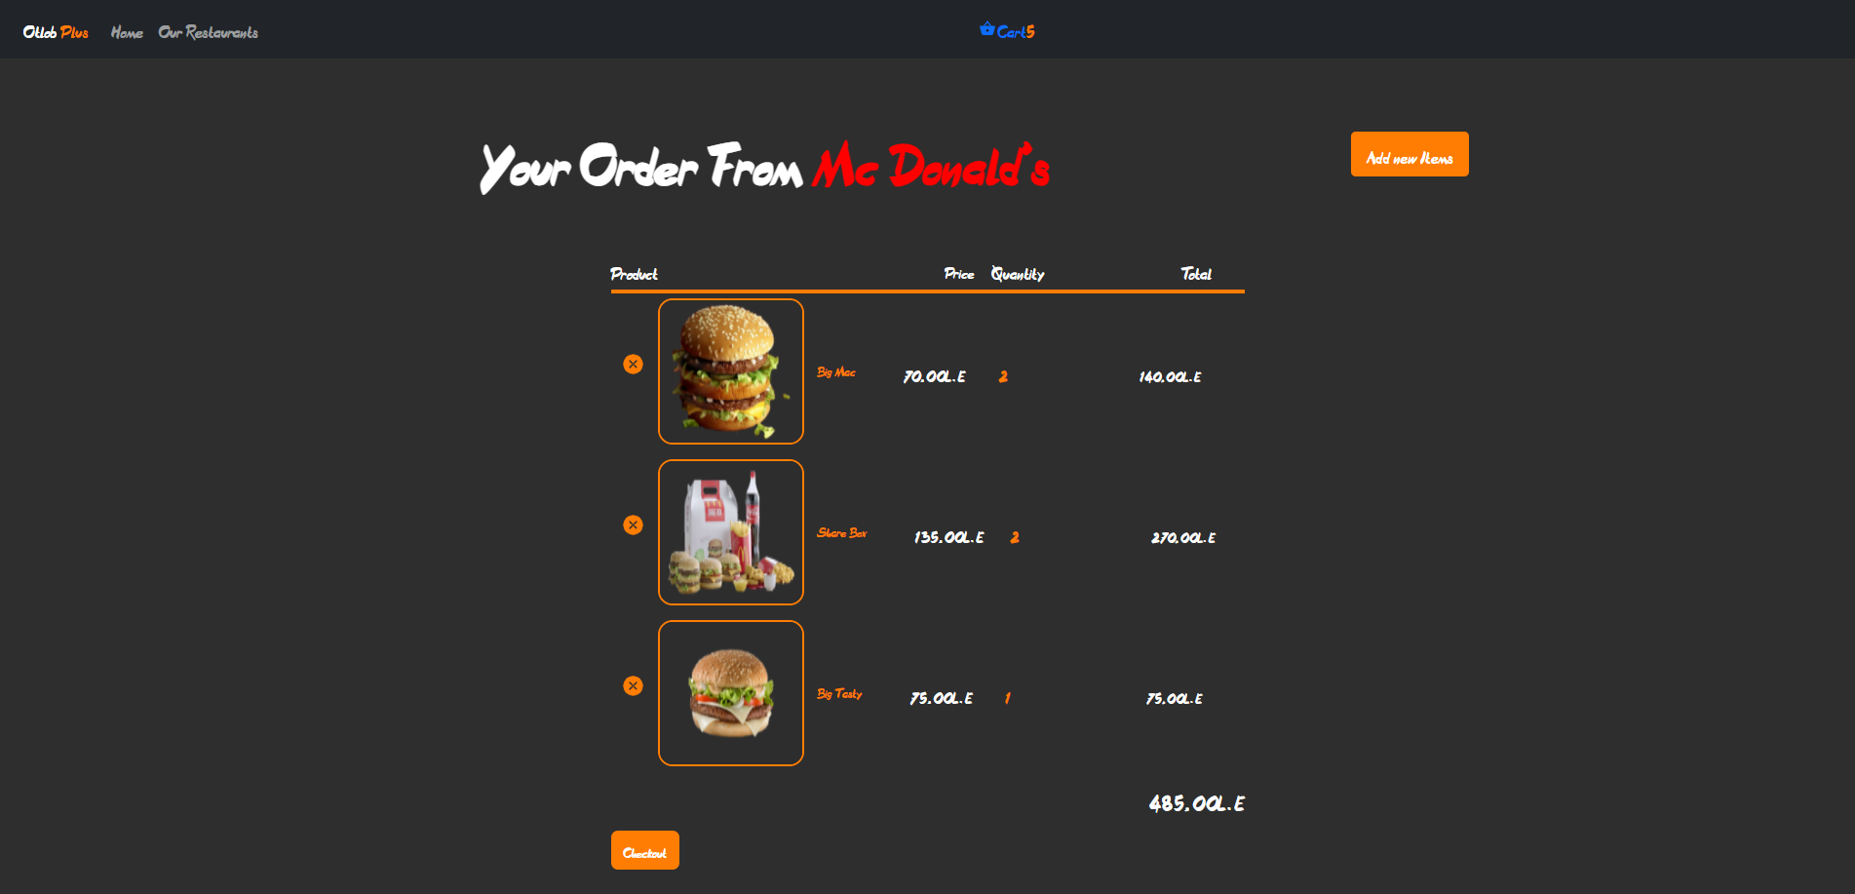
CART TO CHECKOUT

Slide 14
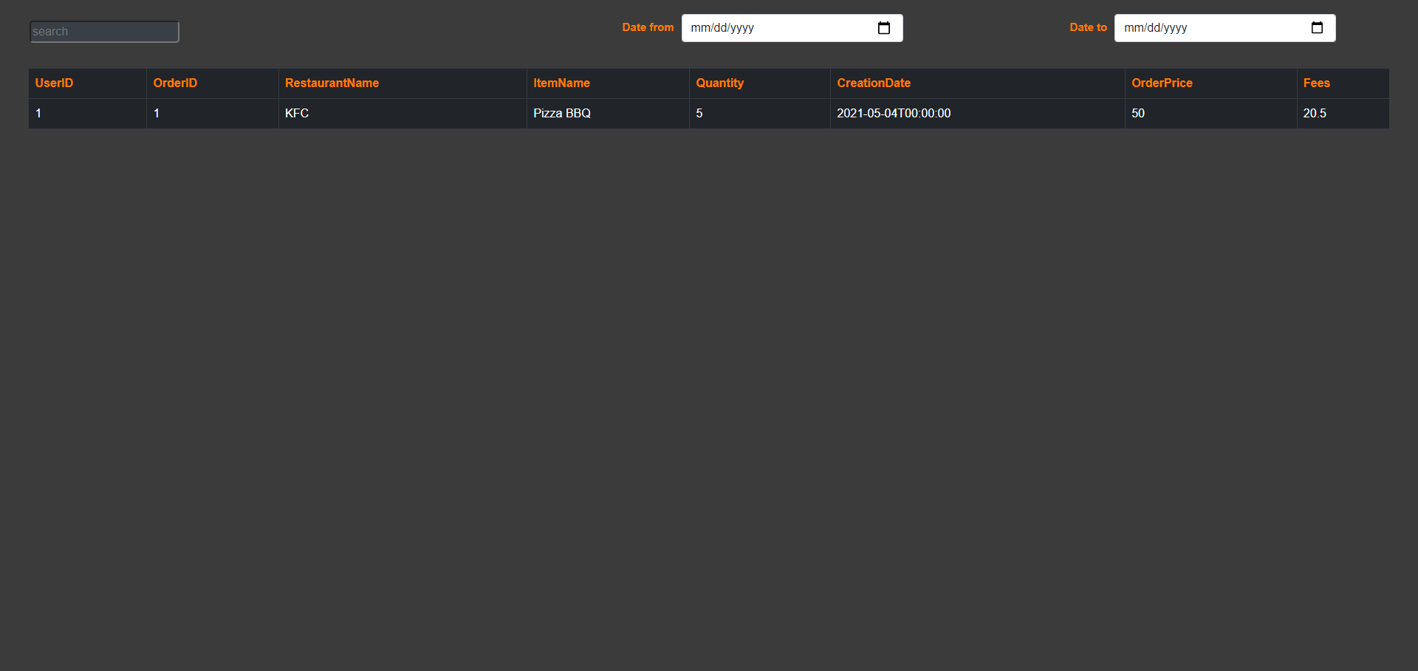
Your Orders

Slide 15
Thank You
David Wagih Roshdy
Marco Ehab William
AboBakr Nabil Abdel Aziz

